Slide 1
Chapter 4
Dynamic Programming

Slide 2
为什么要学习动态规划
动态规划是理解书后面内容的一个基础. 实际上后面的所有的方法都可以被看做是能得到动态规划的效果, 只是能够使用更少的计算量, 而且不用假设需要一个完美的环境.

Slide 3
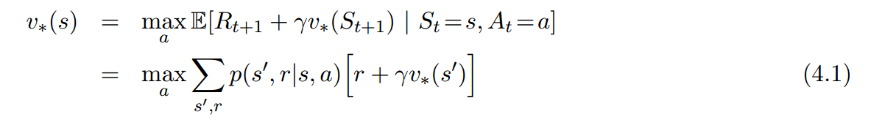
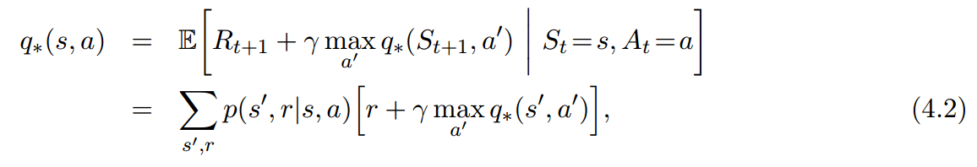
动态规划的中心思想
使用价值函数来构建对最优策略的搜索.
Bellman optimality equations

Slide 4
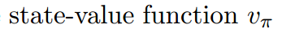
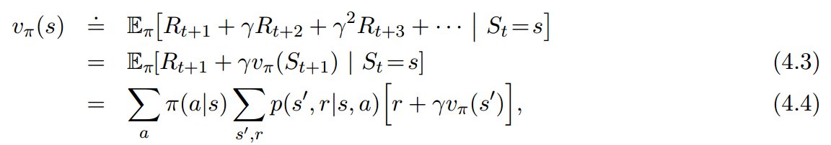
4.1 Policy Evaluation
在一个策略下, 我们怎么知道我们当前所处的状态是好是差?
在当前状态下, 我们对于之后所有累积回报的期望.
但是我们怎么知道下一个状态的期望累积回报呢?

Slide 5
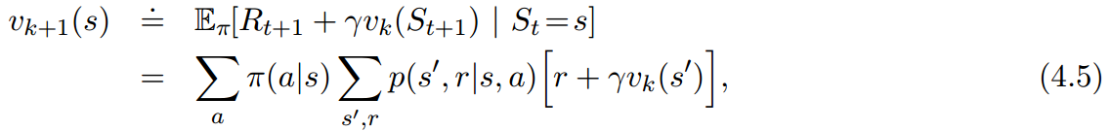
4.1 Policy Evaluation
使用Bellman equation来迭代价值函数 -> iterative policy evaluation

Slide 6
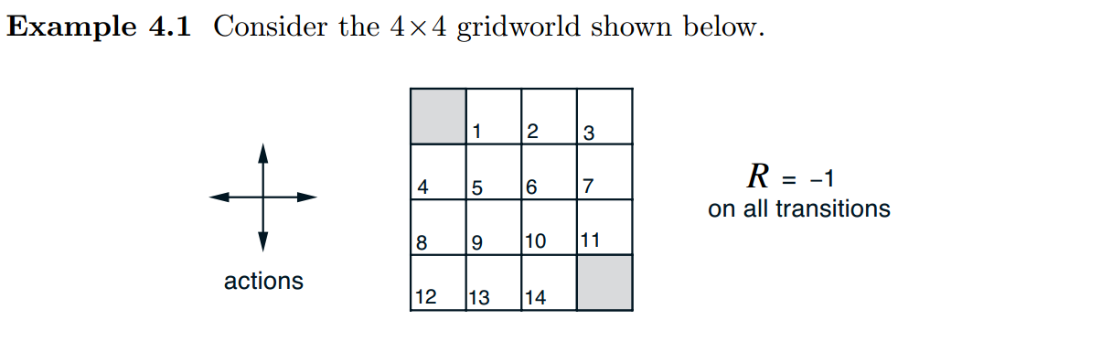
4.1 Policy Evaluation
举个例子

Slide 7
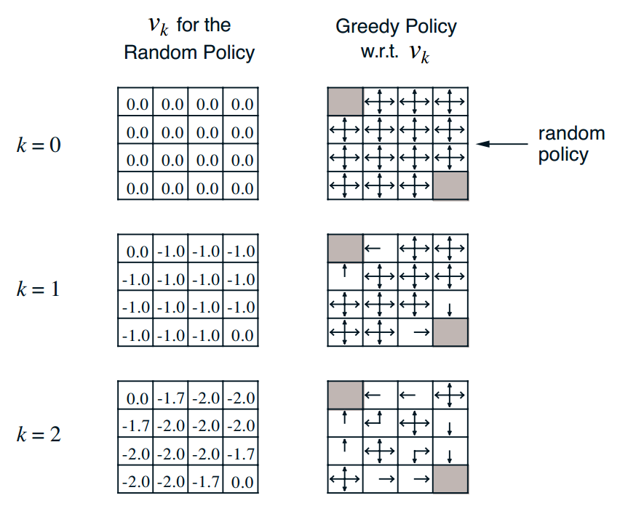
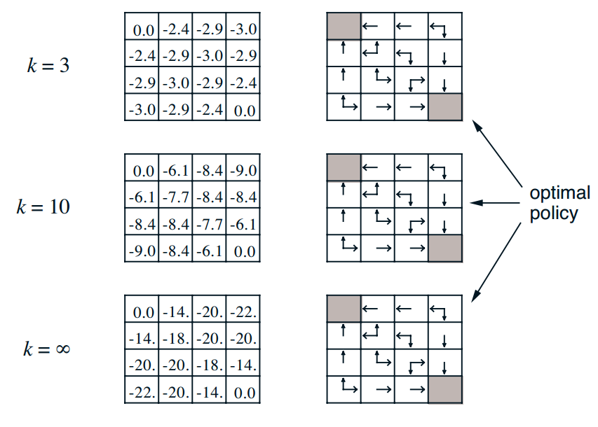

Slide 8
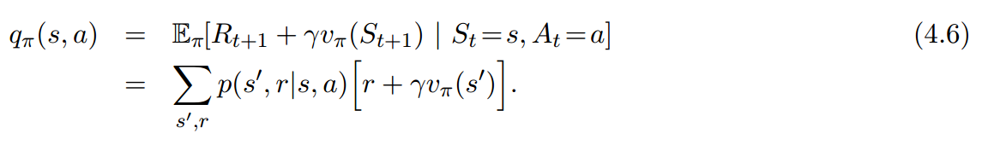
4.2 Policy Improvement
我们已经知道在一个策略下我们所处的状态的好坏
我们还需要知道我们是不是要改变当前的策略, 我们应该怎么样改变策略

Slide 9
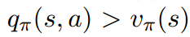
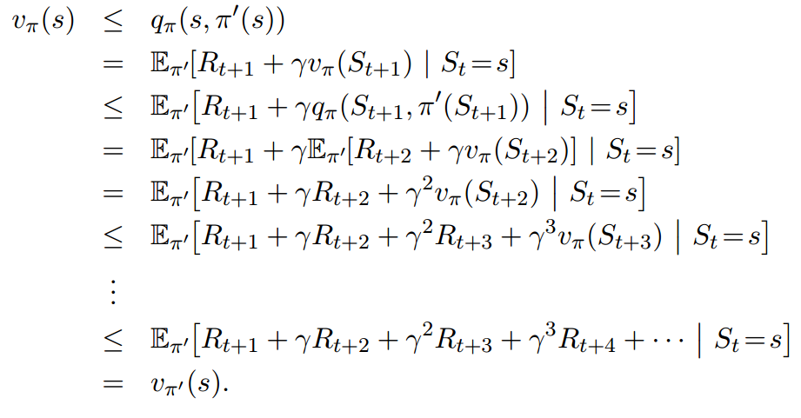
4.2 Policy Improvement
如果满足 那么就代表你能够提高这个行为的选择概率, 从而使得你的策略价值变得更高.
书上的证明

Slide 10
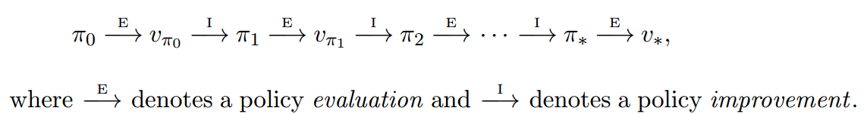
4.3 Policy Iteration
上面只是对一次的价值进行更新, 如果我们需要获得最优的策略
很自然就能想到

Slide 11
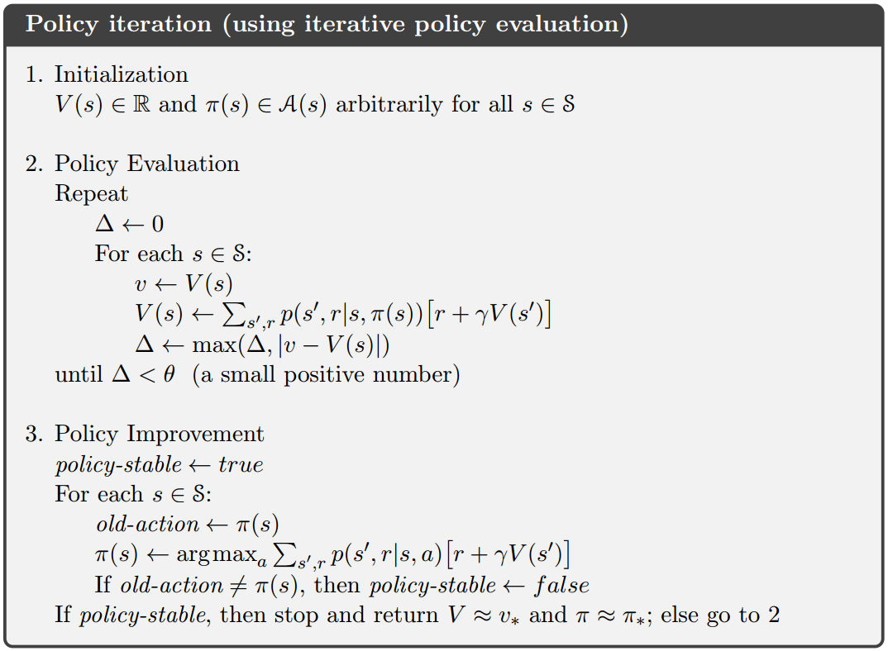
4.3 Policy Iteration

Slide 12
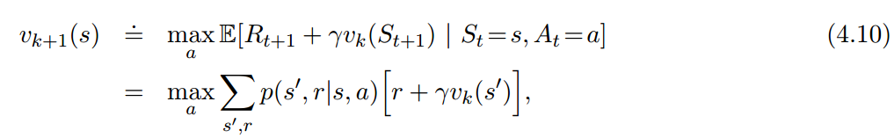
4.4 Value Iteration
对于例子4.1来说, 其实3次迭代之后我们就已经获得了最好的策略
如果继续进行策略的更新实际上是没有多大意义的

Slide 13
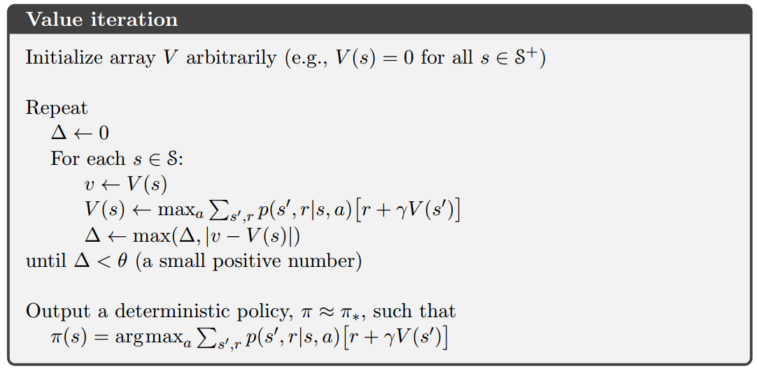
4.4 Value Iteration

Slide 14
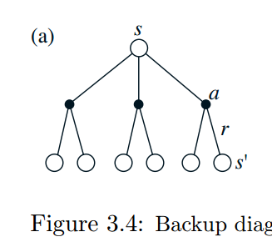
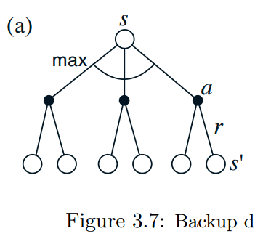
4.4 Value Iteration
Figure 3.4a shows the backup diagram for policy evaluation
Figure 3.7a shows the backup diagram for value iteration

Slide 15
4.5 Asynchronous Dynamic Programming
每次更新value function的时候需要对整个状态空间进行更新
如果状态空间非常大, 其更新的时间也会相应的增多
异步更新

Slide 16
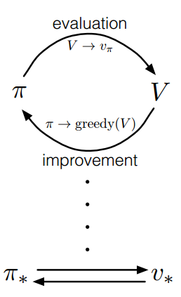
4.6 Generalized Policy Iteration

Slide 17
4.6 Generalized Policy Iteration
The evaluation and improvement processes in GPI can be viewed as both competing and cooperating. They compete in the sense that they pull in opposing directions.
Making the policy greedy with respect to the value function typically makes the value function incorrect for the changed policy,
and making the value function consistent with the policy typically causes that policy no longer to be greedy.
In the long run, however, these two processes interact to find a single joint solution: the optimal value function and an optimal policy.

Slide 18
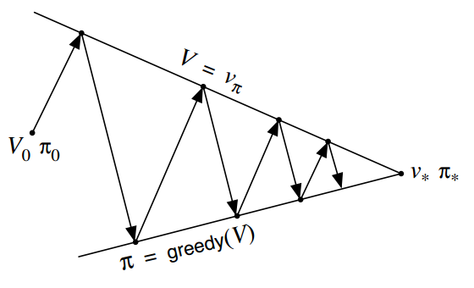
4.6 Generalized Policy Iteration

Slide 19
4.7 Efficiency of Dynamic Programming
DP比详尽搜索的计算量要小得多, 可以保证在多项式时间内得到最优解
维度灾难会造成使用DP的难度加大, 但也不是不能解决问题
在现今的计算水平, DP算法或者算法的变种在实际中很常用

Slide 20
4.8 Summary
Finally, we note one last special property of DP methods. All of them update estimates of the values of states based on estimates of the values of successor states.
That is, they update estimates on the basis of other estimates. We call this general idea bootstrapping.
Many reinforcement learning methods perform bootstrapping, even those that do not require, as DP requires, a complete and accurate model of the environment.

